Slide 1
Module 3: GATE Cloud
Introduction to GATE Cloud
Ian Roberts (i.roberts@sheffield.ac.uk)

Slide 2
This session will be recorded
Recorded video will be available after this session

Slide 3
GATE Cloud Overview
Online platform operated by the GATE team
https://cloud.gate.ac.uk
Two principal strands
Dedicated servers
Processing pipelines
Free rate limited REST API
PAYG batch processing
Originally launched around 2010

Slide 4
Dedicated servers - briefly
Rent a virtual server pre-installed with our software
Pay per hour of running time
Two types of server available
Mímir indexing and search engine for GATE documents
Twitter data collector
Covered in more detail this afternoon in Social Media module

Slide 5
GATE Cloud Pipelines
Recall: in GATE you build complex processing pipelines out of simple components
GATE Cloud lets us publish “pipeline-as-a-service”
80+ pipelines available
https://cloud.gate.ac.uk/shopfront

Slide 6
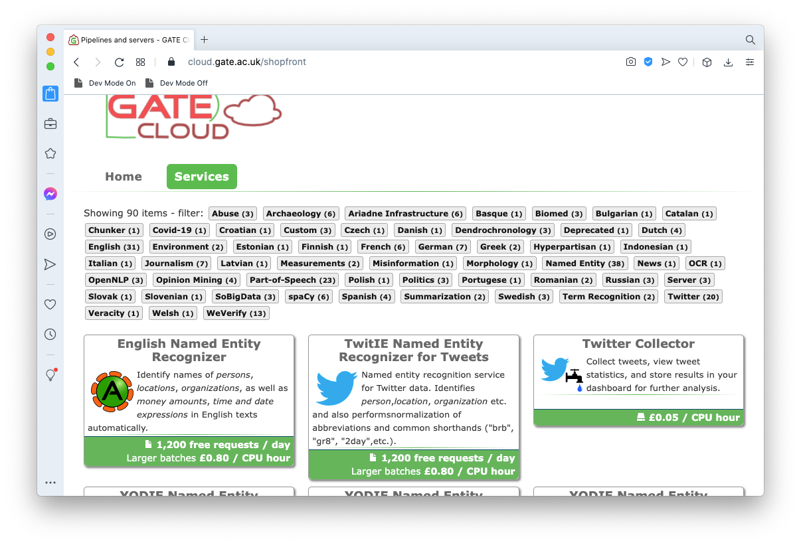
GATE Cloud Pipelines

Slide 7
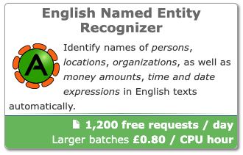
Using a GATE Cloud Pipeline
Two interfaces
“Online” API
Send one text, get back annotations immediately
Free but quota-controlled
Batch “annotation job”
Process large bundles of data in parallel
Unlimited, pay-as-you-go
We will focus mainly on online API

Slide 8
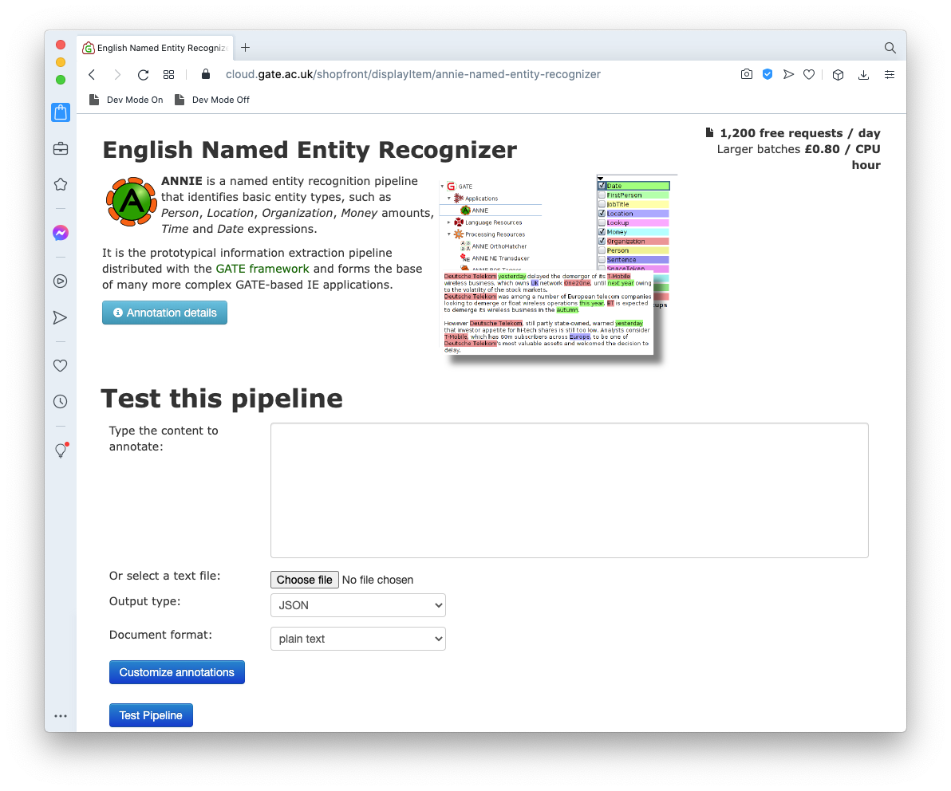
Trying it out
You can try out any pipeline direct from the user interface
Enter text you want to process
Results shown as colour highlights, much like the GATE Developer UI
Try it yourself!

Slide 9
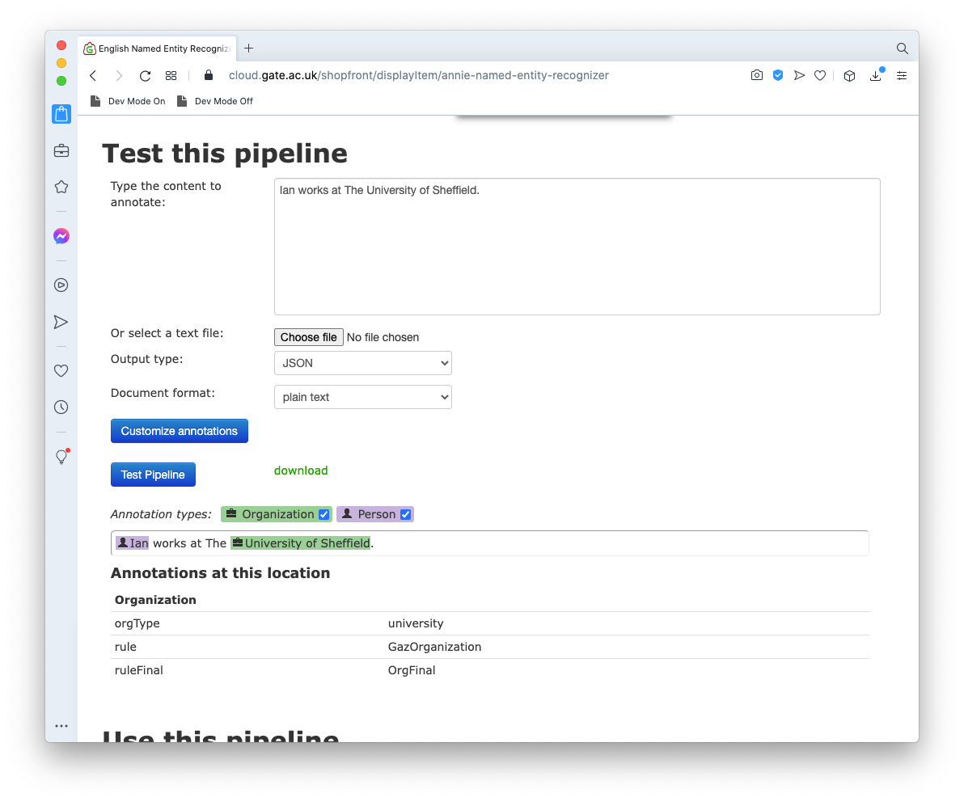

Slide 10
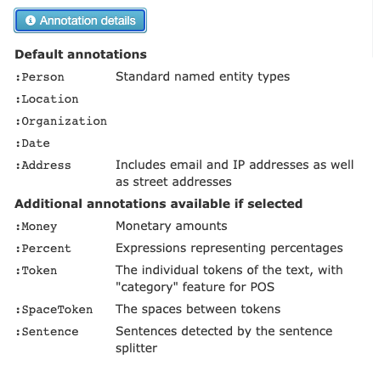
Setting parameters
One pipeline can produce several different annotations
Each pipeline specifies its “default” and “additional” annotation types
Click “annotation details”

Slide 11
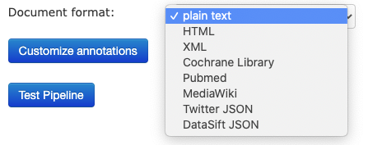
Setting parameters
“Customize annotations” to select the types you want
GATE Cloud services can handle any document type that GATE can parse - select “document format”

Slide 12
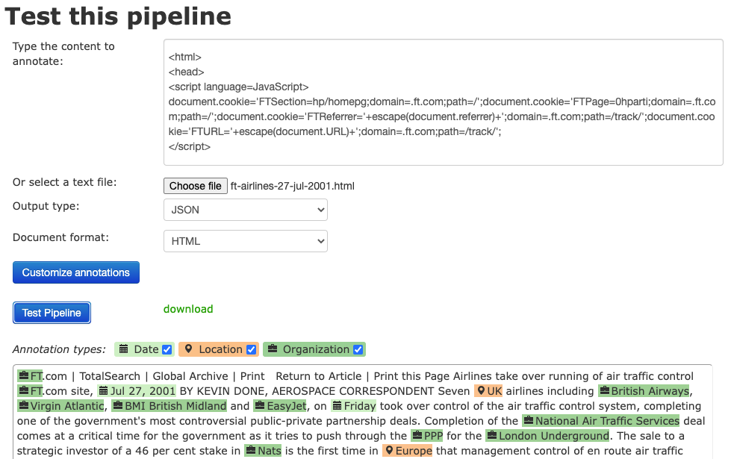
Example - processing HTML
Load an HTML file
Set the format
Text parsed out of the HTML

Slide 13
Output formats
Choose JSON or XML output format
Both produce the same clickable view but the “download” link gives access to the raw API response
XML is the GATE standoff XML format - for examples see the documents you used in module 1
JSON is based on Twitter data format

Slide 14
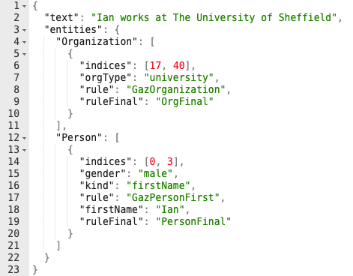
JSON example
“entities” has a list of annotations of each type
“indices”: [start,end] positions within the “text”, exactly* as in GATE Developer
* not quite exactly, if text has emoji

Slide 15
Using the API
Try out interface is simply one front end on top of API
You can call the same API directly from your own code, in any language with an HTTP client
We have developed clients for
GATE Developer
Google Sheets

Slide 16
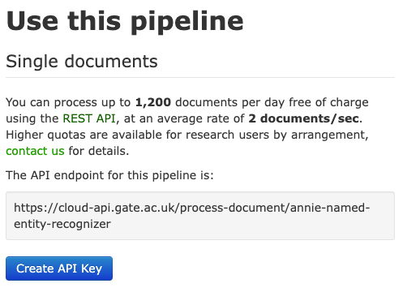
Using the API
Each pipeline has its own endpoint URL
HTTP POST to that URL with the document as body (with appropriate value for Content-Type header)
JSON response by default, Accept: application/xml to get XML instead
Full docs on cloud.gate.ac.uk

Slide 17
Authentication and rate limits
Public pipelines work without authentication, but at very low daily quota and rate limit
1 call per 10 seconds on average
~100 calls per day
The advertised 1,200 per day, 2 calls per second is the baseline for registered users
To get this quota you must authenticate using an API Key

Slide 18

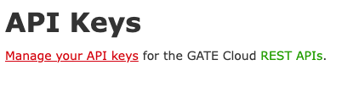
GATE Cloud API Keys
If you haven’t already, register now for an account on GATE Cloud
If you have already registered, log in
Go to “<your name> account” in the top right
Scroll to the bottom and “Manage your API keys”
Generate a new key

Slide 19
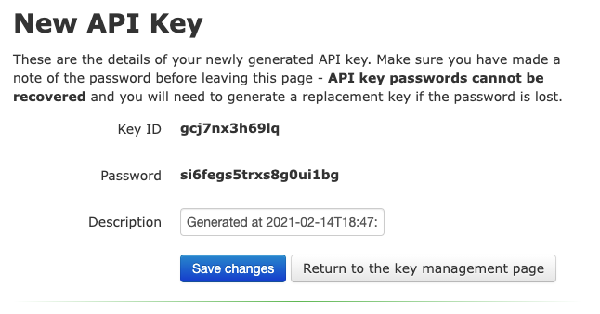
GATE Cloud API Keys
API key is in two parts, the “key ID” and the “password”
Copy and paste both into a text editor for future reference
Note the warning: if you lose the password you must generate a new key (changing both ID and password)

Slide 20
Python example
Open this notebook (Google Colab)
Save a copy in your own Google Drive
Example of how to call GATE Cloud with the requests module

Slide 21
Calling GATE Cloud in Developer
We provide a GATE PR to call a GATE Cloud pipeline
Start GATE Developer
Load the “GATE Cloud Client” plugin
Create a new “GATE Cloud API Client” processing resource

Slide 22
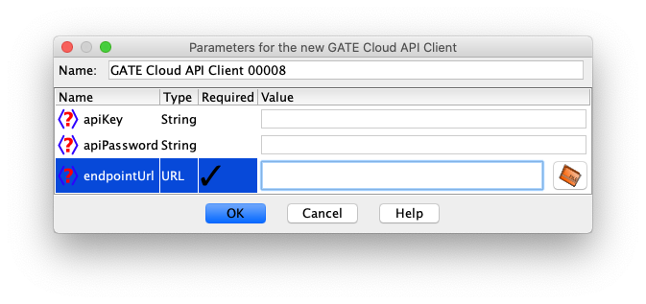
Calling GATE Cloud in Developer
Parameters
apiKey - the key ID you just created
apiPassword - the matching password
endpointUrl - the URL copied from “use this pipeline”

Slide 23
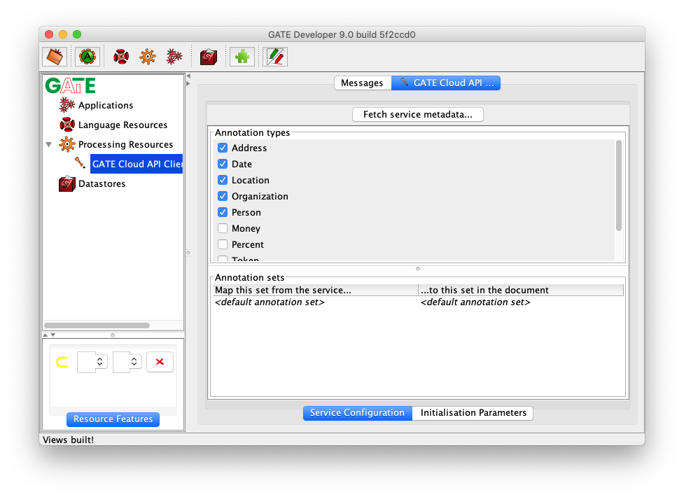
Configuring the PR
Double-click the new PR in the tree, then “fetch service metadata”
Annotation type checkboxes as on “test this pipeline”
Annotation sets…

Slide 24
Annotation sets and types
Recall: in GATE each document has one or more annotation sets, each containing annotations of one or more types
Think back to those “annotation details”
See the colon - “:”
Annotations are specified to GATE Cloud as selector expressions “SetName:AnnotationType”
Most pipelines use the default set (which has no name)
Default annotations
:Person
:Location
:Organization

Slide 25

Mapping annotation sets
By default, cloud client PR puts annotations that come back from service into the same set the service used
But this is configurable
e.g. call ANNIE, but put its output into a set called “cloud”

Slide 26
Try it
Configure your GATE Cloud Client PR to map ANNIE default set to local “cloud” set
Load a document
Create a corpus (shortcut - you can right-click on the document, then “new corpus with this document”)
Load the default ANNIE application
Add the GATE Cloud Client PR to the end of the ANNIE pipeline
Run the app over your (one document) corpus

Slide 27
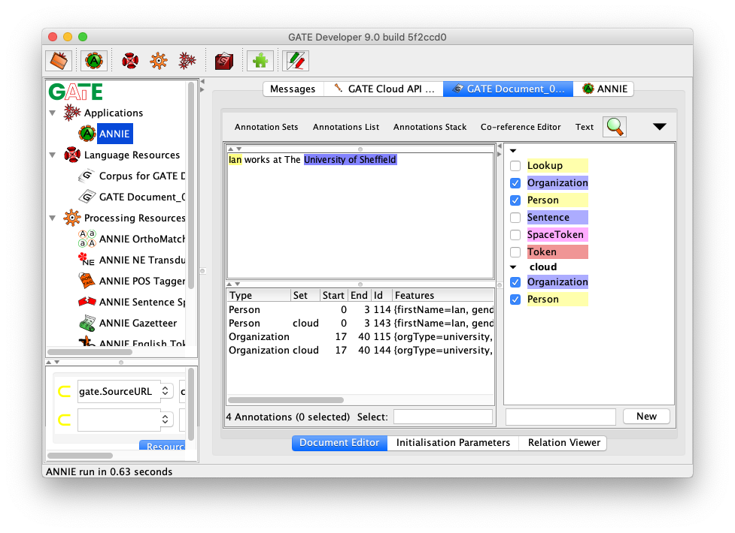
Try it
Cloud ANNIE has found the same annotations as local ANNIE

Slide 28
Try a different service
ANNIE is a good test, but not one you’d really use in this way
There are other pipelines on GATE Cloud that are not available for you to run locally
Delete your Cloud Client PR
Create another one calling a different service
e.g. YODIE
YODIE uses the “Shef” annotation set by default

Slide 29
Google Sheets
We have recently developed an add-on for Google Sheets to process text in a spreadsheet
Particularly useful for people who are comfortable with spreadsheets but not programming
Currently in beta - not yet a published add-on you can install to your own sheets
For testing purposes take a copy of this Google Sheet
You can only view the original, not edit it
go to File → “Make a copy”

Slide 30
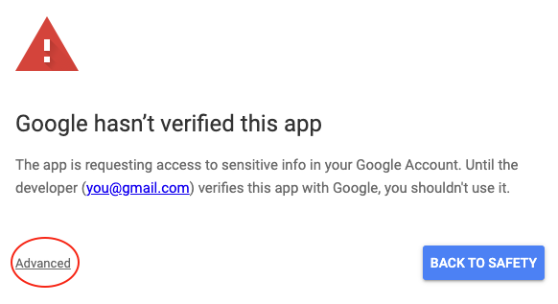
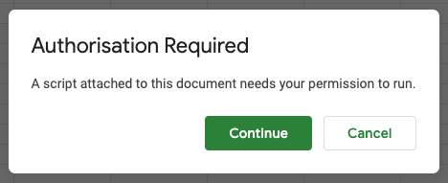
Authorisation
In your copy of the sheet, “Add-ons” → “GATE Cloud Text Analysis” → “Open sidebar”
First time you do this it will request authorisation
Your email will appear as the developer, this is normal!

Slide 31
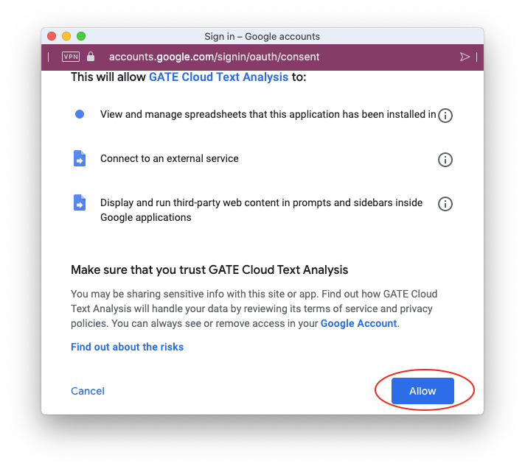
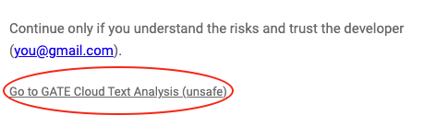
Authorisation
When the add-on is published properly then we will be the developer and it won’t be considered “unsafe”

Slide 32
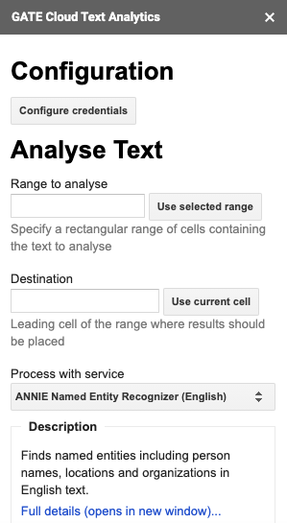
Using the add-on
Once authorised, “open sidebar” again
“Configure credentials” lets you supply your API key ID and password
Intended workflow
Choose a column of texts to process
Typically, set destination immediately to the right of the top-most input cell
For input B2:B9, destination would be C2
Choose the service to use
Configure annotations you want to extract using column headings

Slide 33
Demo
The “BBC example” sheet has a few BBC news articles
Select the cells with input text (B2 to B9)
Under “Range to analyse” click “use selected range”
We will put the output alongside - click into cell C2, then under destination click “use current cell”
Results from processing B2 will go in C2, D2, …
B3 will go in C3, D3, …
Etc.
Select ANNIE as the service to use

Slide 34
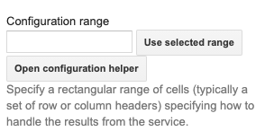
Configuring annotations
One service can produce many different annotations
Approach taken here is to map output into several columns
“Configuration range” (typically column headers) defines what to extract
Scroll sidebar down, click “Open configuration helper”

Slide 35
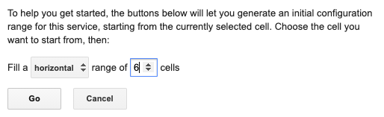
Configuring annotations
Click into cell C1, fill a horizontal range of 6 cells
You will see C1 to H1 filled with headings, and the range selected - click “Use selected range”
Column headings are annotation types

Slide 36
Explanation
To summarise: you’ve now configured the tool to
process the text in B2:B9
using ANNIE
extract the annotations specified by C1:H1
and put the results in cells starting at C2
“Submit job”
The tool will post each input cell in turn to GATE Cloud
If the input set were bigger, you’d see a percentage progress bar
Tool is careful to respect rate limit & quota, and will slow down processing or wait if necessary for quota to reset

Slide 37
More advanced configuration
For a column heading like “Person”, tool outputs the text under each Person annotation in the API response
But we know GATE annotations have other features
Configuration is actually a pattern language that can extract any combination of features for each annotation

Slide 38
More advanced configuration
AnnotationType pattern
pattern can be any sequence of feature names separated by spaces or punctuation
Person gender → male Location text (locType) → Sheffield (city)
text is a “magic” feature name representing the text under the annotation (like @string in JAPE)

Slide 39
More advanced configuration
Configuration helper creates drop-down options on the headers but these are not exhaustive
You can edit the headings to fit your requirements
Use “test this pipeline” to see what features are available
“Full details” link under service description will take you there

Slide 40
Another example - YODIE
Let’s run a different pipeline on the same texts
Range to analyse is still B2:B9
Service: “YODIE named entity disambiguation (English)”
Destination: use cell I2
Configuration helper: click in I1 and generate a one-cell range, then “use selected range”
Drop down I1 to see example configs
All the same Mention annotation type, but different combinations of features - inst is the DBPedia instance URI

Slide 41
Another example - YODIE
Submit the job and let it process
Note “Myanmar” and “Burma” both map to the same concept in DBPedia
It’s not perfect - “the WHO” is treated as the band, not the World Health Organization

Slide 42
Batch processing overview
If you want to process large numbers of documents in a hurry
Upload documents as ZIP files
or collect data from Twitter (see module 4)
Reserve an “annotation job”, either for a standard pipeline, or upload your own
Processing done on Amazon EC2 with many VMs in parallel
Output as JSON or (ZIP files of) XML like the online API
Pay for the compute time you use - buy credit vouchers from the University of Sheffield online shop

Slide 43
Summary
GATE Cloud offers a REST API to process text with any of our published pipelines
API can be called by any client that speaks HTTP(S)
“Test this pipeline”
PR from GATE Developer
Your own code in Python/Java/golang/etc.
Google Sheets
Everyone gets a basic free quota, enhanced quotas available for research users on request
PAYG batch mode for larger jobs

Slide 44
Links
Home page: https://cloud.gate.ac.uk
API spec: https://cloud.gate.ac.uk/info/help/online-api.html
Java library: https://github.com/GateNLP/cloud-client
Thank you!

